Slide 1

Research Methodology
Unit 3
Data Representation
Dr. Arti Arya
Department of Computer Science and Engineering

Slide 2

Research Methodology
Data Representation
Dr. Arti Arya
Department of Computer Science and Engineering

Slide 3
Research Methodology
Disclaimer
These slides are prepared from the prescribed text book and other reliable resources from the Internet.
The images are imported from various sites and videos are imported from youtube.com

Slide 4

Research Methodology
Scientific Publishing- Data representation
PRESENTATION OF DATA
refers to the organization of data into tables, graphs or charts, so that logical and statistical conclusions can be derived from the collected measurements.
Data may be presented in(3 Methods):
Textual
Tabular or
Graphical.
Text, tables, and graphs are effective communication media that present and convey data and information
4

Slide 5
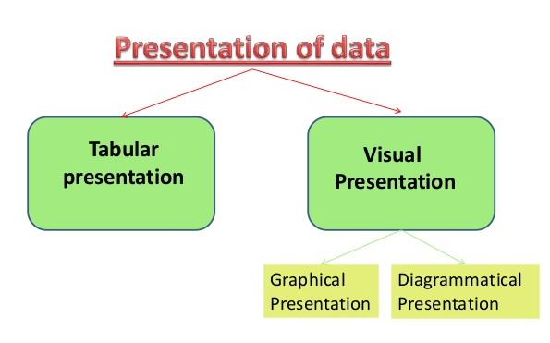

Research Methodology
Scientific Publishing- Data representation
5

Slide 6

Research Methodology
Scientific Publishing- Data representation
When a good amount of data is collected, it becomes necessary for the researcher to arrange it in concise and logical order. This is referred to as tabulation.
A Table refers to any data which is presented in orderly rows across and/or down the page, often enclosed within borders.
A Figure refers to any other form of presentation such as a bar or pie chart, a graph, a diagram, a map, a photograph, a line drawing or a sample of material.
6

Slide 7

Research Methodology
Scientific Publishing- Data representation
Tabulation is important and essential because:
Conserves space and reduces explanatory and descriptive statements to a minimum.
Facilitates the process of comparison.
Facilitates the summation of items and detection of errors.
Provides a basis for various statistical computations.
7

Slide 8

Research Methodology
Scientific Publishing- Data representation
Tabular Presentation of data is a method of presentation of data.
It is a systematic and logical arrangement of data in the form of Rows and Columns with respect to the characteristics of data.
It is an orderly arrangement which is compact and self-explanatory.
8

Slide 9

Research Methodology
Scientific Publishing- Data representation
In a tabular presentation, data is arranged in columns and rows, and the positioning of data makes comprehension and understanding of data more accessible.
Table number. It is included for identification and becomes easy for reference in future.
Title.
Stub.
Caption.
Body.
Footnote.
9

Slide 10
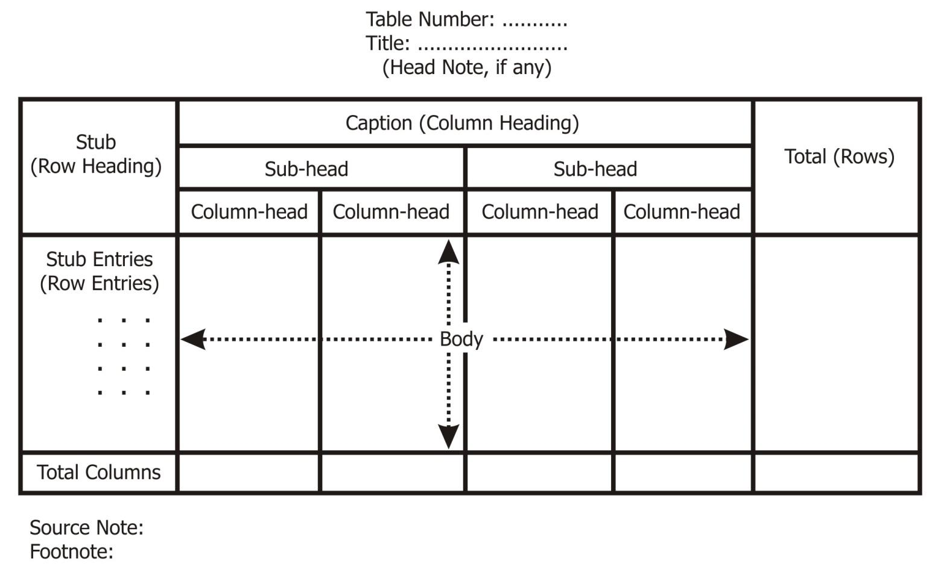
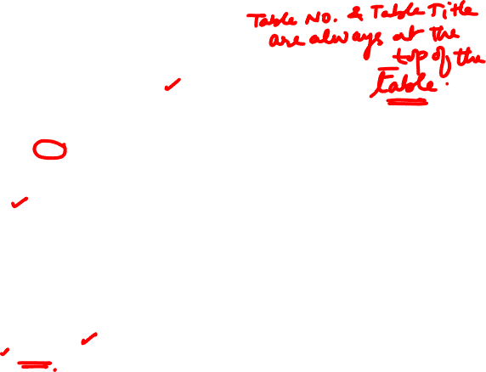
Research Methodology
Scientific Publishing- Data representation
10

Slide 11
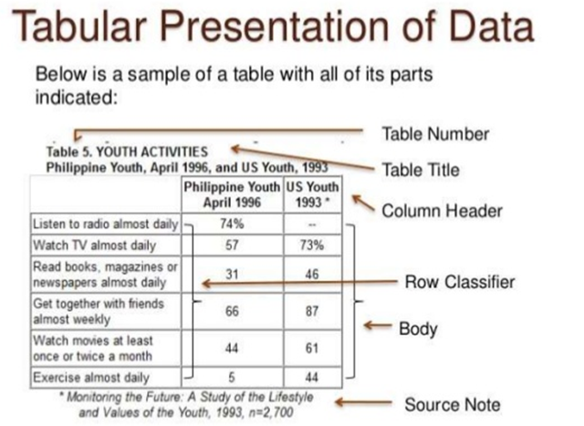
Research Methodology
Scientific Publishing- Data representation
11

Slide 12
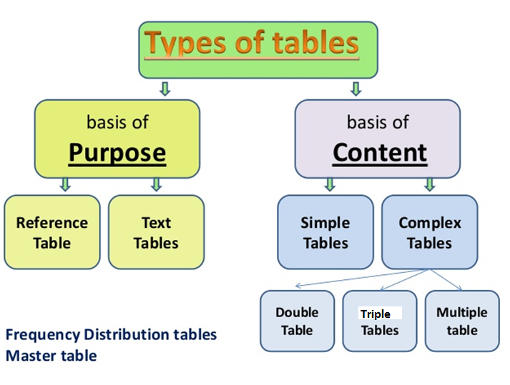
Research Methodology
Scientific Publishing- Data representation
12

Slide 13
Research Methodology
Scientific Publishing- Data representation
Advantages of table:
A table facilitates representation of even large amounts of data in an attractive, easy to read and organized manner.
The data is organized in rows and columns.
Table is one of the most widely used forms of presentation of data since data tables are easy to construct and read.
One of the major benefits of using an Excel table is that it will automatically expand when you add a new record – even if it is added at the end of the table. So the range of cells that your name refers to will also automatically expand. This is known as a dynamic range.
13

Slide 14

Research Methodology
Scientific Publishing- Data representation
Table and its Characteristics:
1. A table is perceived as a two-dimensional structure composed of rows and columns.
2. Each table row represents a single entity occurrence within the entity set.
3. Each table column represents an attribute, and each column has a distinct name.
14

Slide 15

Research Methodology
Scientific Publishing- Data representation
Numerical Tables:
These are the most common types of data, which typically represent quantitative data, but sometimes may present a combination of quantitative and qualitative data.
As its name suggests, most of the body of the table consists of specific number values.
15

Slide 16

Research Methodology
Scientific Publishing- Data representation
Features for good table
Attractive: It should be attractive as to leave good impression on reader.
Clarity: A table should be simple and clear i.e. can easily be understood.
Manageable size: Too much details should not be there and the size of the table should be medium i.e. neither too big nor too small.
16

Slide 17
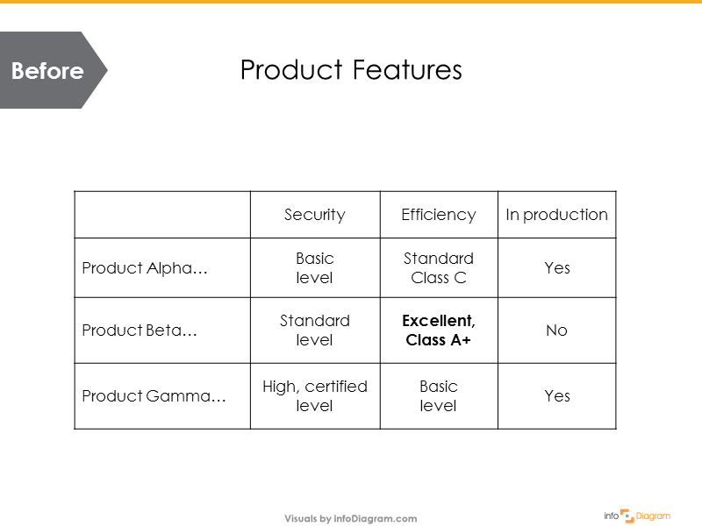

Research Methodology
Scientific Publishing- Data representation
17

Slide 18
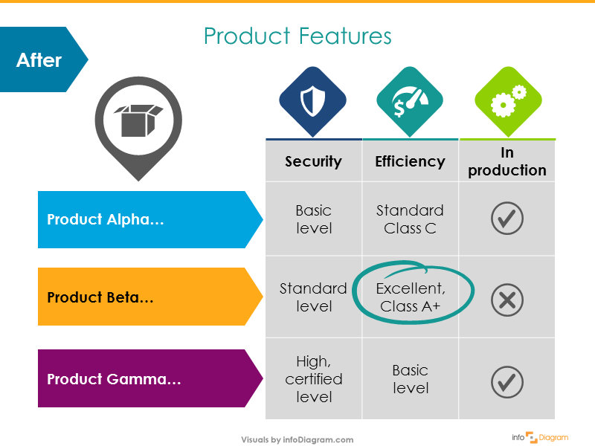

Research Methodology
Scientific Publishing- Data representation
18

Slide 19
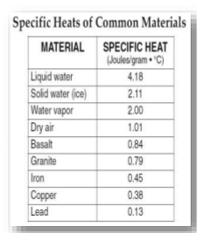
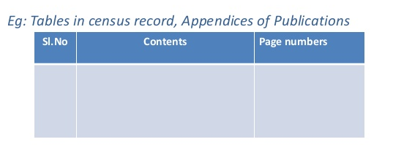
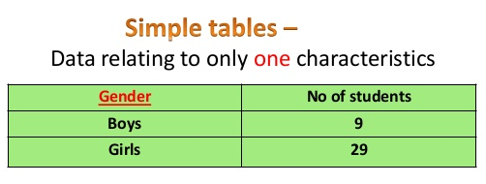
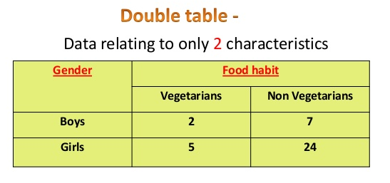
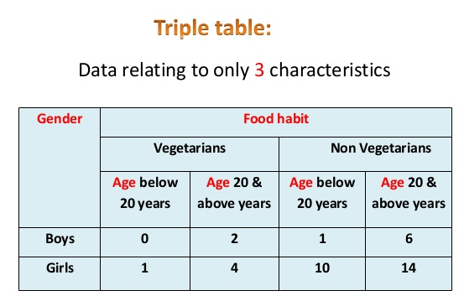
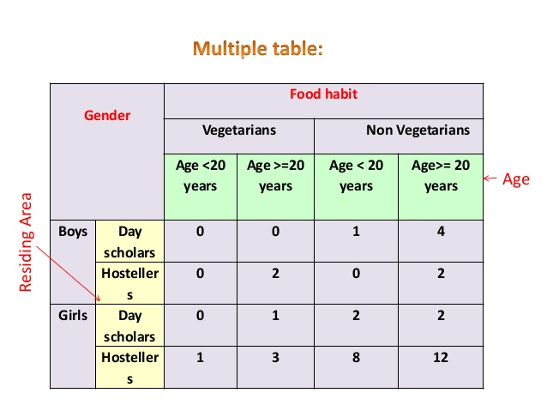
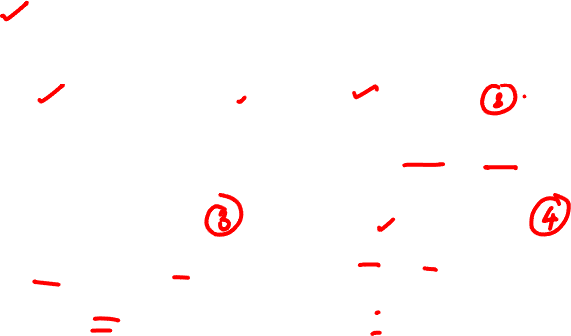
Research Methodology
Scientific Publishing- Data representation
19

Slide 20
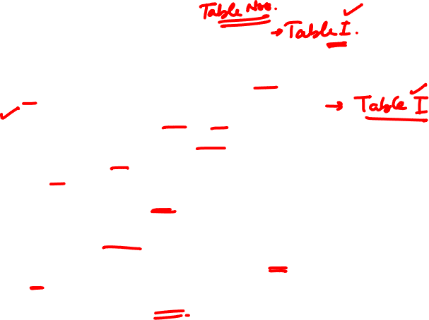
Research Methodology
Scientific Publishing- Data representation
Some Generally accepted principles of Tabulation:
Clear, concise, adequate title
Distinct number for proper referencing.
Col headings and row headings should be clear.
Units of measurements must be indicated.
Sources from where the data is taken must be indicated immediately below the table.
Abbreviations should be avoided.
20

Slide 21
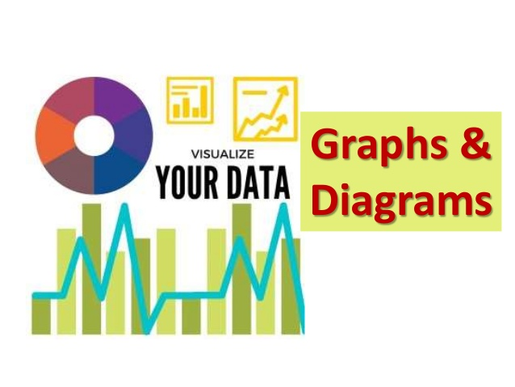
Research Methodology
Scientific Publishing- Data representation
21

Slide 22
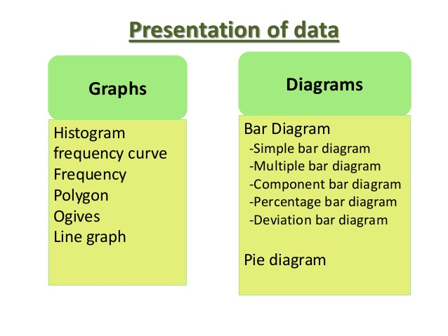

Research Methodology
Scientific Publishing- Data representation
Visualization, as the word suggests is the art of representing information in visual form like diagrams, charts or images. The visuals are usually supported by narration from the presenter.
22

Slide 23
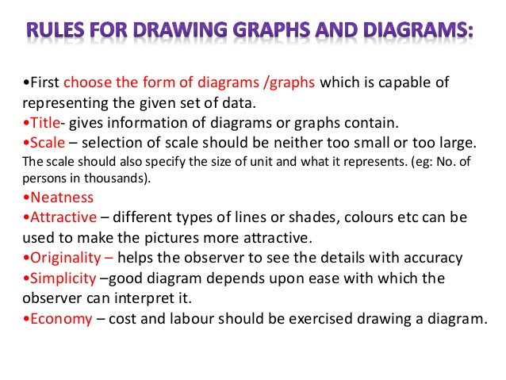

Research Methodology
Scientific Publishing- Data representation
23

Slide 24
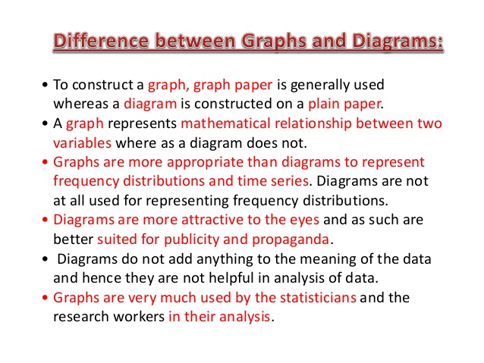

Research Methodology
Scientific Publishing- Data representation
24

Slide 25
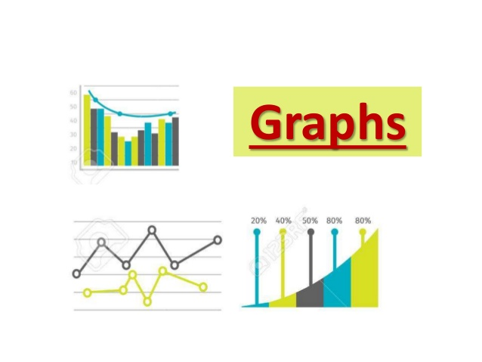
Research Methodology
Scientific Publishing- Data representation
25

Slide 26

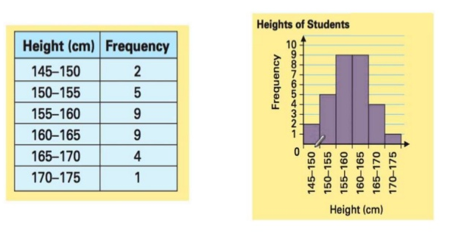
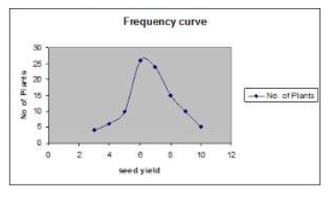
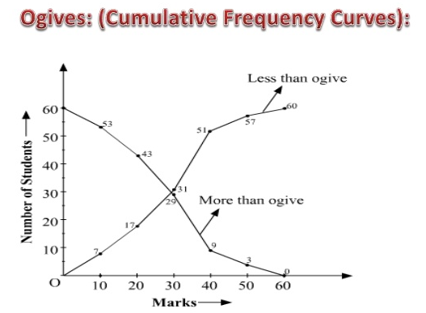

Research Methodology
Scientific Publishing- Data representation
26

Slide 27
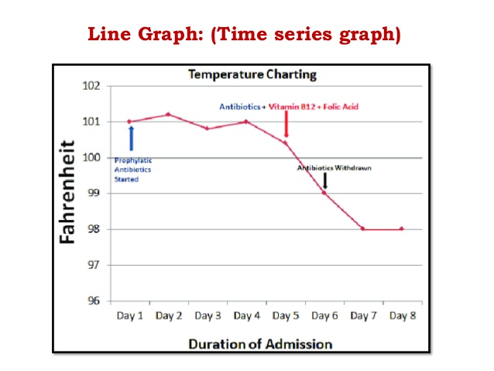
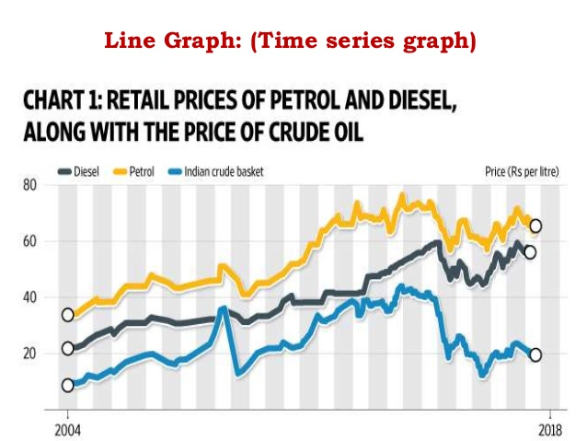

Research Methodology
Scientific Publishing- Data representation
27

Slide 28
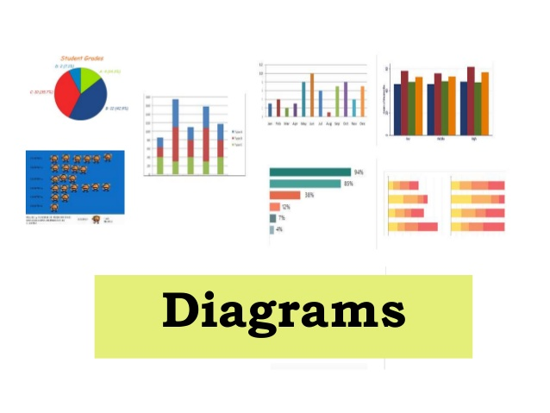
Research Methodology
Scientific Publishing- Data representation
28

Slide 29
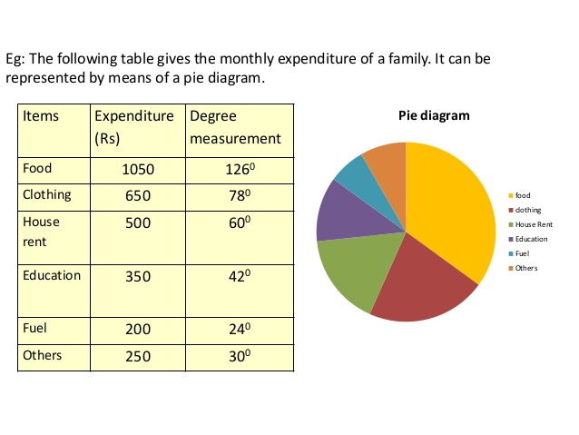
Research Methodology
Scientific Publishing- Data representation
29

Slide 30
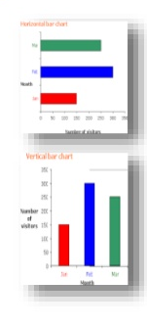
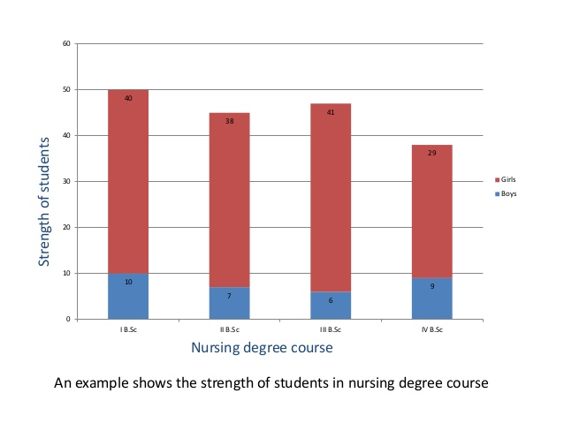
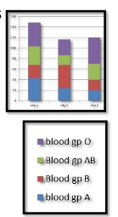
Research Methodology
Scientific Publishing- Data representation
30

Slide 31
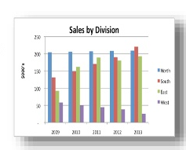
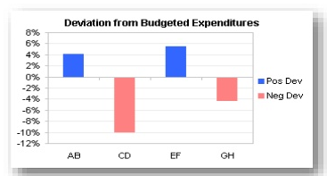
Research Methodology
Scientific Publishing- Data representation
31

Slide 32
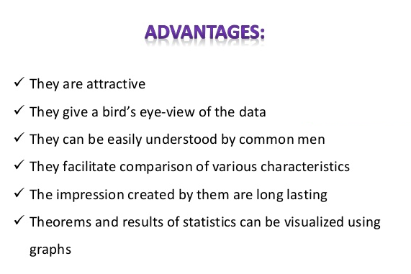

Research Methodology
Scientific Publishing- Data representation
32

Slide 33
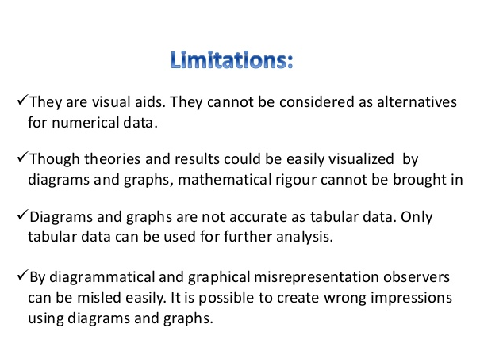

Research Methodology
Scientific Publishing- Data representation
33

